Slide 1
DevOps Big Picture
Notes:
https://courses.cs.washington.edu/courses/cse403/13au/lectures/git.ppt.pdf
http://enos.itcollege.ee/~jpoial/allalaadimised/git/getting-started-with-git.pdf

Slide 2
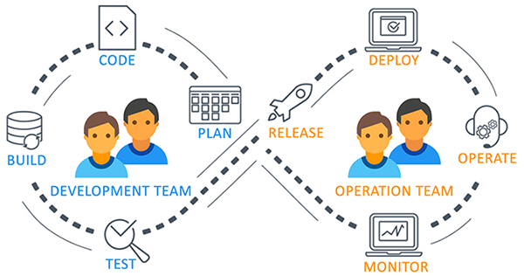
What and why of DevOps?

Slide 3

What and why of DevOps?

Slide 4
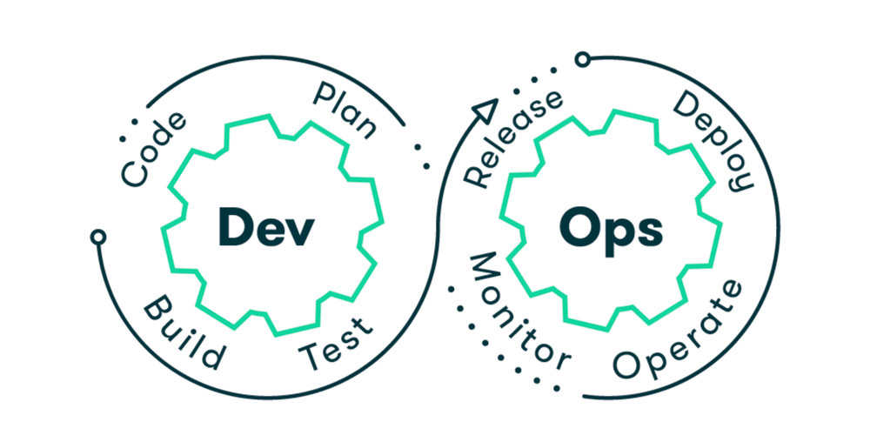
What and why of DevOps?

Slide 5
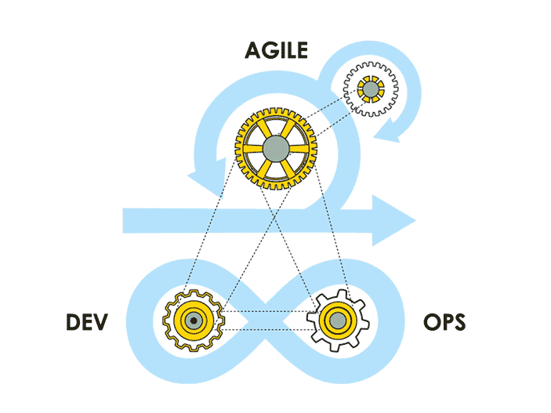
What and why of DevOps?

Slide 6
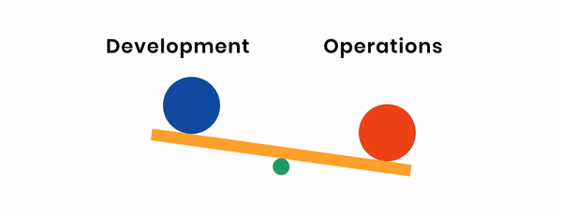
What and why of DevOps?

Slide 7
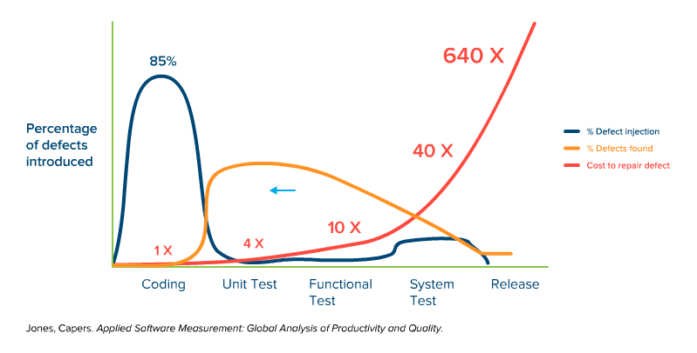
Early Defects vs Delayed Defects detection

Slide 8
DevOps Tools – Overview and Use case

Slide 9
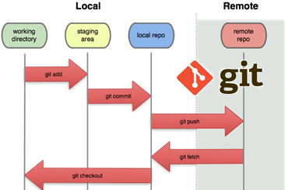
Source control
To ensures for working on the right version
Important for maintaining a single source of truth

Slide 10
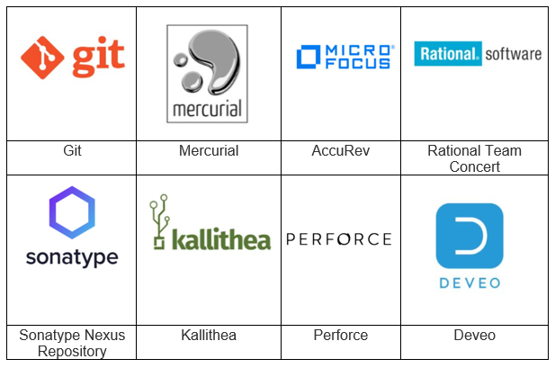
Source Control Management (SCM Tools)
Help to keep track of code
Complete history of changes.

Slide 11
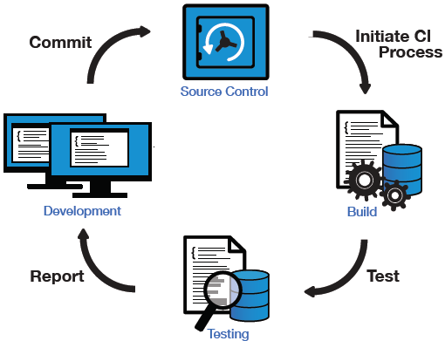
Continuous Integration

Slide 12
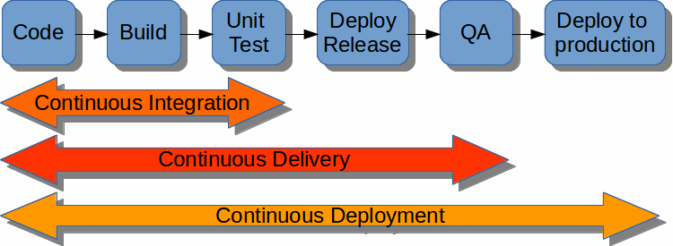
Continuous Delivery and Deployment

Slide 13
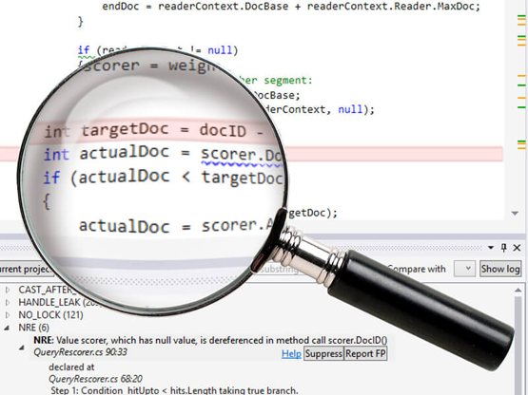
What Is Static Code Analysis?
A method of debugging
Examine source code before a program is run
Done by analyzing a set of code against a set of coding rules.
Performed early in development

Slide 14
Static Code Analysis Tool
Development teams are under pressure
Quality releases needed to be delivered on time
Coding and compliance standards need to be met
And mistakes are not an option.
That’s why development teams are using static analysis tools.

Slide 15
Static Analysis vs. Dynamic Analysis
Static analysis
Identifies defects before running a program (e.g., between coding and unit testing).
Dynamic analysis
Identifies defects after running a program (e.g., during unit testing)

Slide 16
Few Static Code Analysis Tools
Apache Yetus
Code Dx
ConQAT
Coverity
IBM Security AppScan
Facebook Infer
Lint
SonarQube
SourceMeter
For complete list refer:
https://en.wikipedia.org/wiki/List_of_tools_for_static_code_analysis

Slide 17
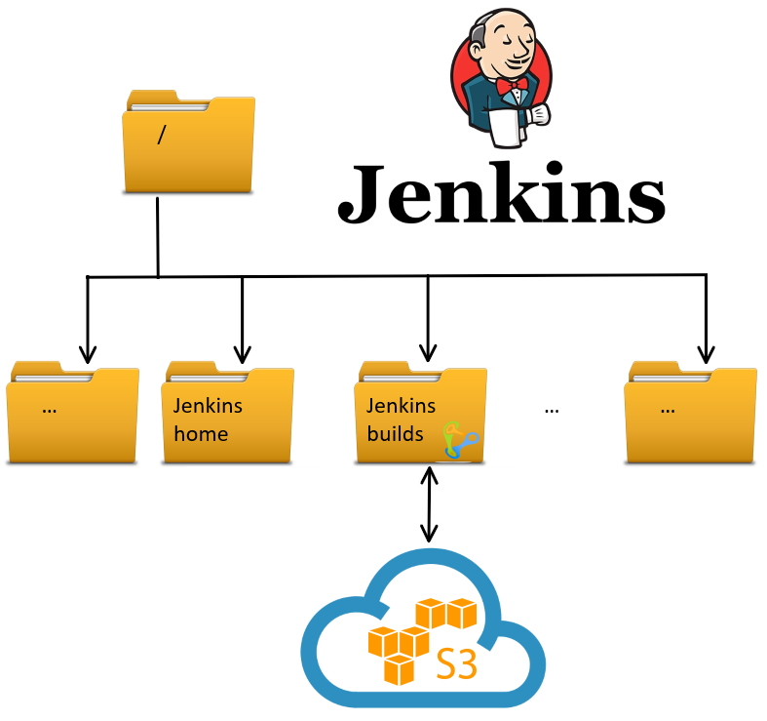
Storage Artifacts

Slide 18
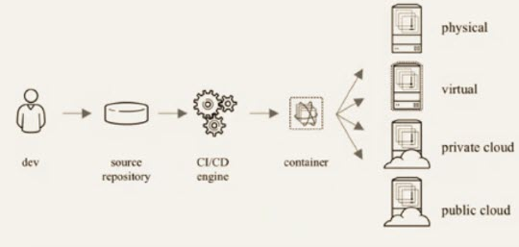
Containerization
Notes:
Containers are a solution to the problem of how to get software to run reliably when moved from one computing environment to another
This could be
From a developer's laptop to a test environment
From a staging environment into production and
From a physical machine in a data center to a virtual machine in a private or public cloud.
A container consists of an entire runtime environment:
An application, plus
All its dependencies, libraries and other binaries, and configuration files needed to run it, bundled into one package

Slide 19
Configuration Management
A process for maintaining
Computer systems
Servers, and
Software in a desired, consistent state
Notes:
Why manage configurations?
Keeps you from making small or large changes that go undocumented
These misconfigurations can lead to poor performance, inconsistencies, or noncompliance and negatively impact business operations and security.
When undocumented changes are made across many systems and applications, it adds to instability and downtime.

Slide 20
Benefits of Configuration Management for Servers
Quick Provisioning of New Servers
Quick Recovery from Critical Events
Version Control for the Server Environment
Replicated Environments

Slide 21
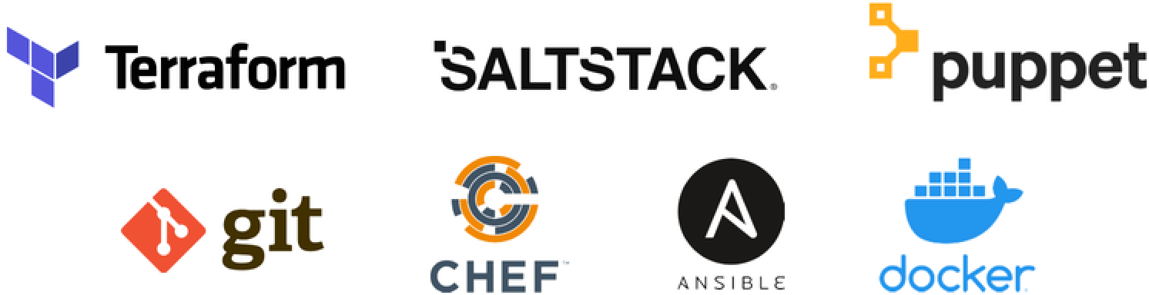
Configuration Management Tools

Slide 22
Thanks

